Slide 1
Single Family Rentals
Ed Coulson
Merage School of Business, University of California, Irvine
Director, Lied Institute for Real Estate Studies, UNLV
Professor Emeritus of Economics, Penn State University
AREUEA Presidential Address, 2017

Slide 2
Tenure Choice and Structure Type
“There are few facts in urban economics as reliable as the fact that people in multifamily units overwhelmingly rent and people in single-family units overwhelmingly own.”
-Glaeser and Shapiro (2003) “The Benefits of the Home Mortgage Interest Deduction”

Slide 3
 | Rental | Owner-occupied | % rental
Single Family | 10.6 | 60.0 | 15.0
Multi Family | 23.5 | 3.8 | 86.1
Number of housing units (000,000s). 2000 Census. Single family includes single family detached and attached. Figures do not include mobile homes, boats, etc.

Slide 4
But, in the last 15 years, 40% of the growth in SF is in rentals
 | Rental | Owner-occupied | % rental
Single Family | 10.6 | 60.0 | 15.0
Multi Family | 23.5 | 3.8 | 86.1
Number of housing units (000,000s). 2000 Census. Single family includes single family detached and attached. Figures do not include mobile homes, boats, etc.
 | Rental | Owner-occupied | % rental
Single Family | 14.6 | 65.8 | 18.2
Multi Family | 25.6 | 3.9 | 86.8
Number of housing units (000,000s). 2011-15 ACS. Single family includes single family detached and attached. Figures do not include mobile homes, boats, etc.

Slide 5
Why is there a correlation between structure type and tenure choice?
The quality hypothesis
Houses are bigger than apartments
Bigger tax break for owner-occupiers, who outbid investors for the largest properties.
Or, more scope for property rights

Slide 6
Coulson and Fisher “Apartment
Rent and Condo Rent” (2014)
 | Apartments |  | Owner-occupied Condos
Variable Obs | Mean | Std. Dev. | Mean | Std. Dev.
pool | 0.39 | 0.49 | 0.49 | 0.50
baths | 1.19 | 0.43 | 1.59 | 0.58
unitsf | 917.19 | 841.24 | 1349.09 | 1175.99

Slide 7
The coordination costs/public goods explanation:
“This connection is not some statistical artifact. It makes sense to have one roof, one owner. When people rent single-family homes, they often take bad care of them… By contrast, in multi-family dwellings, dispersed ownership is a big headache. Think of the battles that roil co-op boards.” (Glaeser, Triumph of the City, 2013, pp. 194-5)

Slide 8
Coulson and Fisher (The Governance of Multifamily Housing, 2015): The coordination costs explanation suggests that in buildings with more units, dispersed ownership is less likely.
But this is not true.

Slide 9
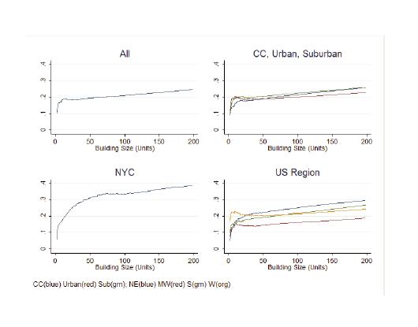
Condo share rises in unit count

Slide 10
Presumably coordination problem is solved with scale economies (at around 15 units) in building management.
(Parenthetically, there is also the “small numbers” problem of default and non-payment of HOA fees; and lender issues)

Slide 11
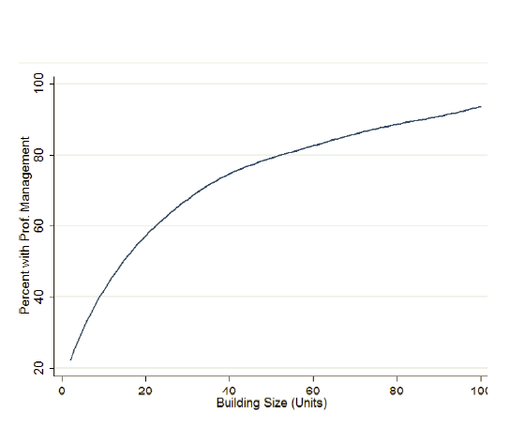
Professional management rises in unit count. (Coulson and Fisher, 2015)

Slide 12
We are led to where property managers already were
The maintenance scale explanation.
Typical manager quote:
  “The expenses of single-family rentals are often greater than those for multifamily rentals due to the lack of economies of scale. When comparing a 20-unit multifamily property to 20 single-family rentals, the costs of repairs and maintenance on the single-family rentals are often higher, as the houses would be located across a broader area. A multifamily property can often have an onsite manager to handle issues, which is not possible with single-family rentals. These differences lead to higher property management expenses.”
Economics literature is pretty silent (exceptions: Linneman (1985), Williams (1993))
But this is congruent with the traditional view of SF rentals as a “mom-and-pop” operation

Slide 13
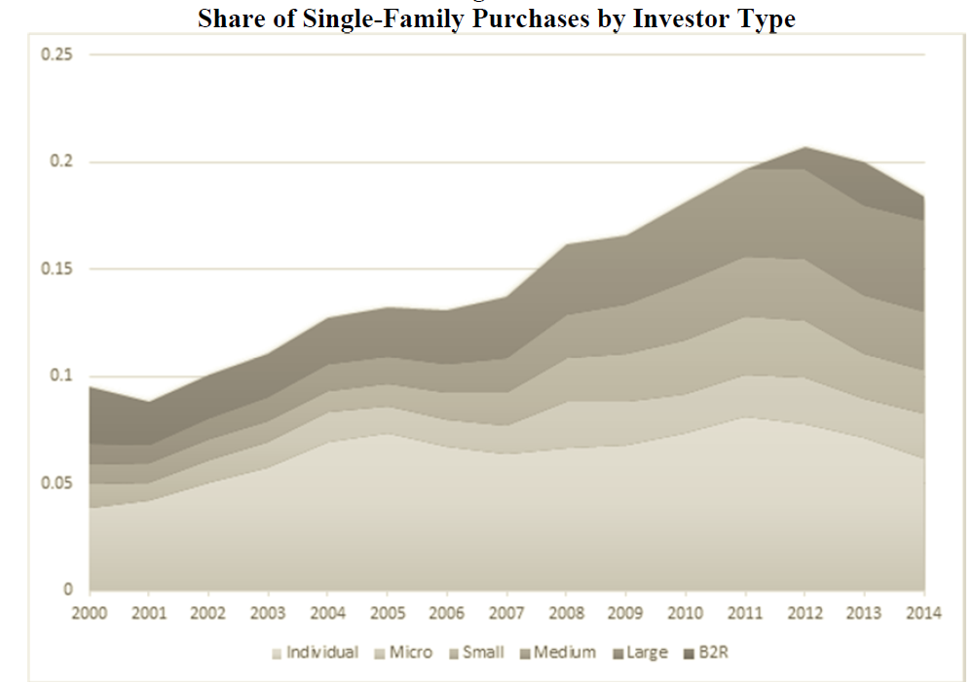
That changed in 2011
… particularly with the emergence of “BTR (large fund) sector”. Mills, Molloy and Zarutskie (“Buy to Rent” Real Estate Economics, forthcoming).

Slide 14
The problems of separated management (Huffington Post)
Here's What Happens When Wall Street Builds A Rental Empire
Posted: 10/25/2013 8:23 am EDT | Updated: 10/25/2013 8:28 am EDT
…The odor greets her before she turns into her driveway each evening as she returns from work. It's there when she prepares dinner, and only diminishes when she and her husband hunker down in their bedroom, where they now eat their meals.
For the $1,225 a month she pays for the three-bedroom house in the quiet suburb of Lilburn, Culpepper thinks it isn't too much to expect that her landlord, Colony American Homes, make the necessary plumbing repairs to eliminate the smell. But her complaints have gone unanswered, she said. Short of buying a plane ticket to visit the company's office in Scottsdale, Ariz., she is out of ideas.
"You can not get in touch with them, you can't get them on the phone, you can't get them to respond to an email," said Culpepper, whose family has lived with the problem since the day they moved in five months ago. "My certified letters, they don't get answered."

Slide 15
What’s new in 2011?
The housing/foreclosure crisis seems to be causal (Schnure, 2014).
(Single family) housing is durable, and drop in owner-occupier demand reduced prices enough to make BTR attractive.
Stabilized the sand state SF housing market
Provided affordable (spacious) housing (by avoiding the downpayment constraint).

Slide 16
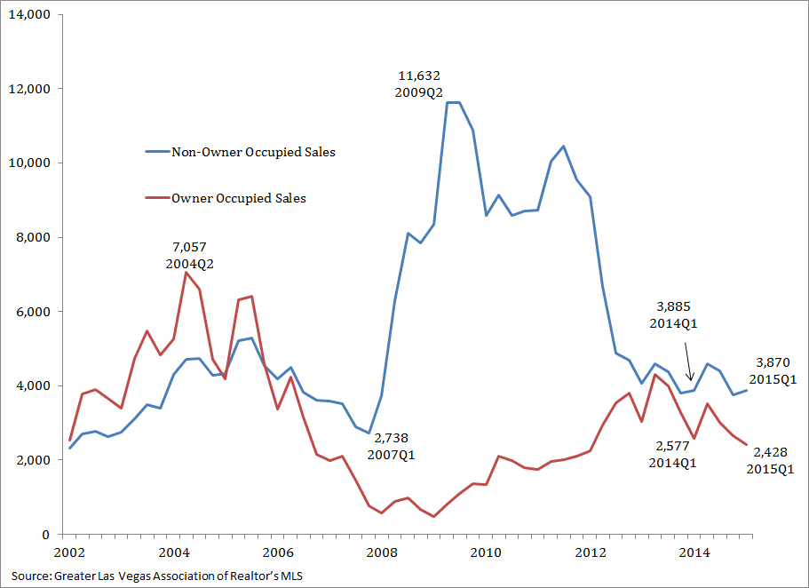

Slide 17
What else is new? Geographic concentration overcomes management problem
“Similarly, Oakland-based Waypoint American Homes abides by geographical rules, with properties located all within a 25-mile radius, at most.” (Multifamilyexecutive.com)
Some evidence in Mills, et al
Is this proper diversification?
Not unlike MF returns?

Slide 18
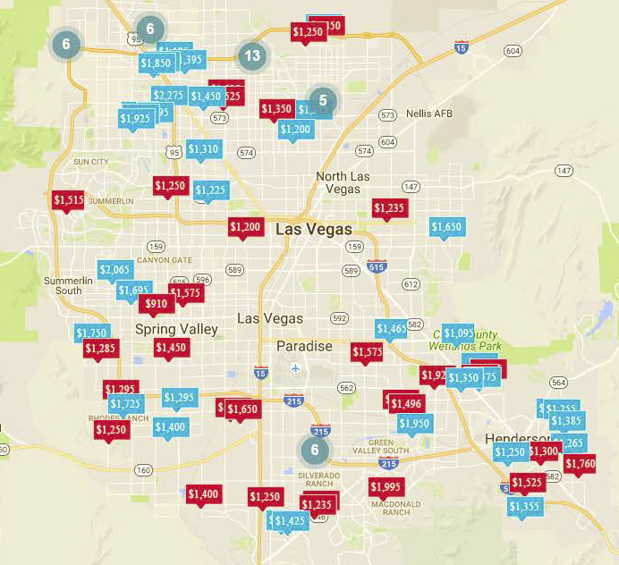

Slide 19
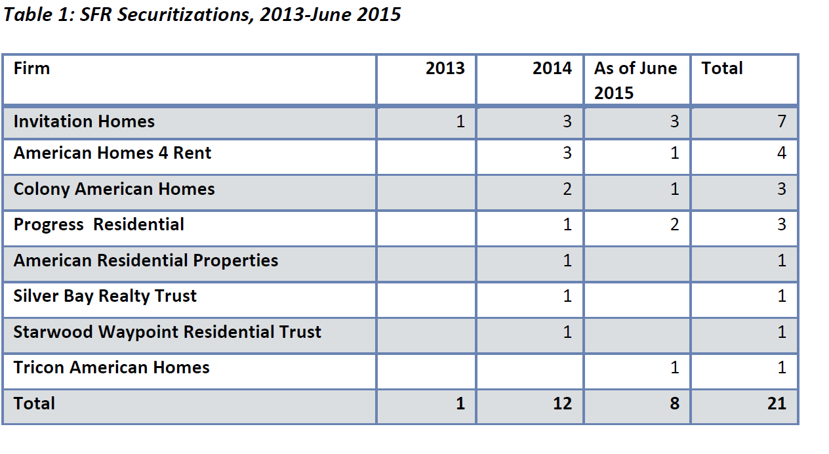
Another stabilizing factor:rent securitization (Fields et al, SF Fed WP)

Slide 20
Blackstone Establishes Single-Family Buy-to-Rent Lending Platform
New York, NY, November 15, 2013. Blackstone today announced that funds managed by Blackstone Tactical Opportunities have established B2R Finance (“B2R”) to provide residential buy-to-rent mortgages for property investors, focused exclusively on the financing needs of single-family home investors.
Jas Khaira of Blackstone Tactical Opportunities said, “We see a great opportunity to fund small-and -medium-sized investors in the single-family space to help them expand their portfolios. We are pleased to welcome the B2R team and look forward to building this business to support the growing single-family rental market.”

Slide 21
Is the rise in SF rentals a problem? Homeowners are nice neighbors
High transaction costs => longer spells
=>greater investment incentive
In both
  Physical maintenance
  Social capital

Slide 22
The rental externality didn’t go away.
Home rentals — the new American Dream? (USA Today 6/6/2012)
GILBERT, Ariz. – Steve and Jodi Jacobson bought their Phoenix­area "dream home" in 2005.
Yet, the combination of rentals and declining home values have taken a toll on The Arbors' appearance, other homeowners say. On a recent Friday night, a home that neighbors said was a rental sat vacant. Its garage door hung crooked and part­way open. Empty moving boxes and debris were stacked out front. "You see fewer people taking care of yards, more parked cars, more people working on cars," says Arbors homeowner Michael Grandy, 35. He moved into the neighborhood in 2008. Michelle House, who bought her Arbors home in 2009 for $163,000, says she's now surrounded by rentals and people she no longer knows. She often picks weeds left in yards.

Slide 23
Does social capital decline?
As Renters Move In, Some Homeowners Fret (New York Times, 8-28-2013)
“Used to, we knew our neighbors,” Ms. Holcomb said. Then she gestured toward the few remaining owner-occupied houses nearby. “Except for the two that have been here, I don’t know any of my neighbors.”
Asked how many renters were active with the neighborhood watch, Mr. Fumich said, “Zero.”

Slide 24
Plenty of evidence, all of it contradictory
Homeowners
  Maintain better
    Galster (1983), Harding, Miceli and Sirmans (2000), Gatzlaff, Green and Ling (1998)
  Have better kids
    Green and White (1997), Haurin, Parcel, and Haurin (2002), Barker and Miller (2009),Holupka and Newman (2012), Green, Painter and White (2012)
  Are better people
    DiPasquale and Glaeser (1999), Engelhardt, Eriksen and Gale (2010)
  Raise property values
    Coulson and Li (2013)
See also Glaeser and Sacerdote (2000)

Slide 25
Tenure and neighborhood change: The case of State College, PA
Shaffner, WPSU, Carroll, Centre Daily Times
“Through the Homestead Investment Program, the borough's Redevelopment Authority, or RDA, plans to beat prospective landlords to the punch by purchasing homes that were rentals or might turn into rentals.
“The RDA would then either rent the houses out only to non-students (this is legal because students are not a protected class under the Fair Housing Act) or resell the homes, but with a restrictive covenant on the deed that prohibits the houses from becoming rentals. They'll do this with a 5 million dollar line of credit that's backed by the borough.
“What worries residents is that the ever-growing demand for student housing means rentals are creeping into quieter, more family-oriented blocks of the neighborhood.”
“The goal of the program is to stabilize… neighborhoods” the Borough Manager said

Slide 26
Coulson and Wommer: Tenure Tipping

Slide 28
Sensitivity to single family rentals has increased in the last two decades
Tipping points have lowered, and the degree of change have increased

Slide 29
So there is a fundamental and difficult tradeoff:
  Single family rentals provide affordable ( in the wealth sense) housing to families who benefit from having detached, spacious living arrangements
  But given the potential problems of separated maintenance, and the different incentives of renters, this may have repercussions for neighborhoods
  All of this is taking place amidst other evolutions in housing preferences (Couture and Handbury, 2016)

